Slide 1
Command Officer Training
Feb. 15, 2020
Stoughton, SK

Slide 2
Welcome and Overview

Slide 3
Welcome Commanders
Welcome and Introductions
Ice Breaker
Seminar Overview

Slide 4
Seminar Overview
Legion’s Mission Statement
Chain of Command
Leadership
Dress and Deportment
District Commander Responsibilities
Zone Commander Responsibilities

Slide 5
Seminar Overview
Conflict Management
Communication
Sports
Membership
Poppy

Slide 6
Legion’s Mission Statement

Slide 7
Legion Mission Statement
To serve Veterans, which includes currently serving military and RCMP members and their families.
To promote remembrance and to serve our communities and our country.

Slide 8
Chain of Command

Slide 9
Chain of Command
Dominion Executive Council
Provincial Executive Council
District
Zone
Command Office
Branch

Slide 10
Being a Leader

Slide 11
Being a Leader
Successful Leader
Dress and Deportment

Slide 12
Successful Leaders
Communicate
Inspire
Build Teams
Resolve Conflict
Be Open To Change
Be Committed
Share The Same Vision

Slide 13
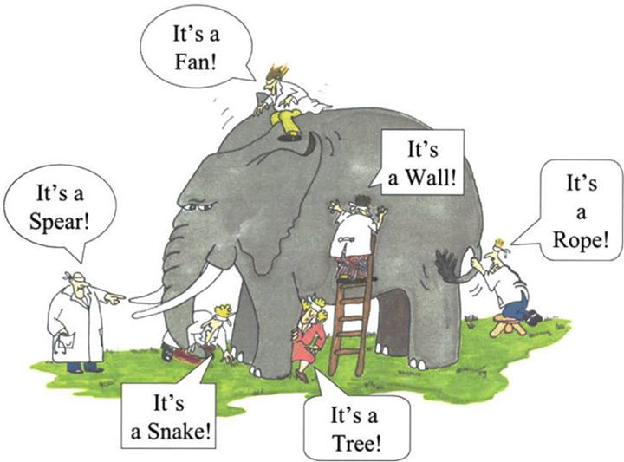
Six Blind Men and the Elephant

Slide 14
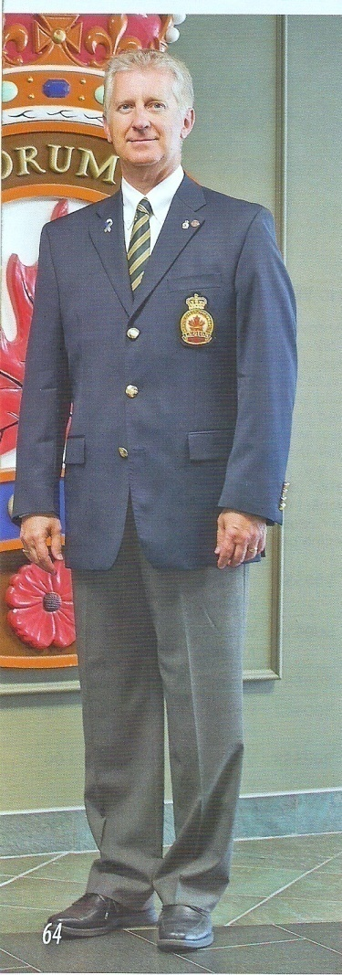
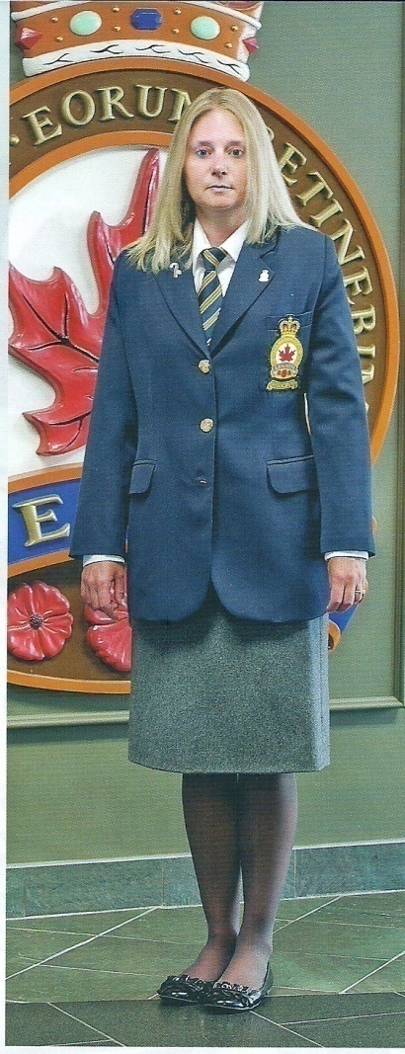
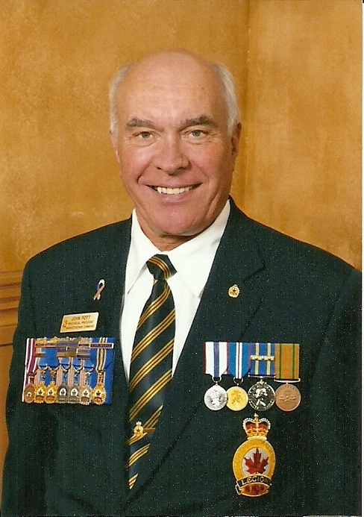
Dress and Deportment
Module 2

Slide 15
District Commander Responsibilities

Slide 16
District Commander Responsibilities
Responsibilities to Command, District, Deputy, and Branch

Slide 17
Zone Commander Responsibilities

Slide 18
Zone Commander Responsibilities
Responsibilities to Command, District, Deputy, and Branch
Branch Operations
Branch Level Job Description
Branch Visits

Slide 19
Responsibilities to Command
Represent Command, relaying information from correspondence, policy changes, and branches issues appropriately.
Collection of branch reports (Branch Financials, Poppy Trusts, Membership Rates, Branch Officer Listing)

Slide 20
Responsibilities to your District Commander
Relay on problems/situations with the branches
Give a copy of each branch visit report
Communicate sporting event dates and locations
Communicate list of winners of zone sporting events in timely manner
Provide the zone winner’s list and stats report for Poster Literary contest
Help plan events and rallies

Slide 21
Responsibilities to your Deputy
Share all duties equally
Prepare them to take over
Empower them to learn
Organize all Events
Ensure they do not overlap
Communicate
Keep abreast of what is happening in the zone

Slide 22
Responsibilities to your Branches
Introductions
Ensure they know who you are
Zone Commanders fund
Establish and report
Communicate
Be available and easy to communicate with
Brainstorming
Offer Assistance
Need Help?
Ask District Commander, Council, Command Office

Slide 23
Branch Operations
Branch Organization
- Branch Autonomy
- Branch Executive
- Committees
Other Resources:
Module 3 – Branch Management
Module 5 – How to conduct a meeting

Slide 24
Branch Level Job Description
Common Branch Positions and Chairs.
Saskatchewan Command Brochures
Other Resources:
Module 1 – Job Description
President | Treasurer | Sgt-At-Arms
Secretary | Service Officer | Chaplain
Chairperson | Poppy Chairperson | Sick & Visiting
Immediate Past President | Membership Chairperson | Sports
Vice President | Public Relations Chairperson | Entertainment

Slide 25
Branch Visits
Must be done each year
Expenses are paid for 1 visit per branch per year
Branch Visit Form is to be completed and sent to your District Commander along with your expense form
Note any problem areas and report on potential solutions. Seek advice when needed.

Slide 26
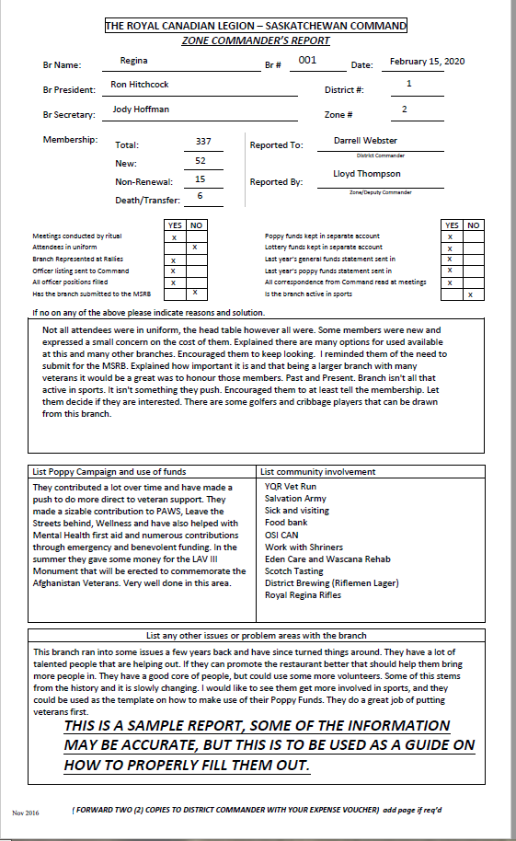
Branch Visits

Slide 27
Conflict Management

Slide 28
Conflict Management
Conflict is inevitable
Team effort to resolve
Resolution styles
Guiding principals
Other Resources:
Module 6 – Listening and Interpersonal Skills
Module 4 – Public Relations and Outreach

Slide 29
Conflict Management

Slide 30
Conflict Resolution Styles
Style | Characteristic | User Justification
Avoidance | Non-confrontational. Ignores or passes over the issue. Denies issues are a problem. | Differences too minor or too great to resolve. Attempts might damage relationships or create even greater problems.
Accommodating | Agreeable non-assertive behaviour. Cooperative even at the expense of personal goals. | Not worth risking damage to relationships or general disharmony.
Win/Lose | Confrontational, assertive and aggressive. Must win at any cost. | Survival of the fittest. Must prove superiority. Most ethically or professionally correct.
Compromising | Important all parties achieve basic goals and maintain good relationships. Aggressive but cooperative. | No one person or idea is perfect. There is more than one good way to do anything. You must give to get.
Problem Solving | Needs of both parties are legitimate and important. High respect for mutual support. Assertive and cooperative. | When parties will openly discuss issues, a mutually beneficial solution can be found without anyone making a major concession.

Slide 31
Guiding Principles
Preserve Dignity and Self Respect
Listen with Empathy
Don’t Expect to Change Others’ Behavioral Style
Express Your Independent Perspective

Slide 32
Communication

Slide 33
Communication
Online Portal
Emails
Correspondence
Other Resources:
Module 6 – Listening and Interpersonal Skills
Module 4 – Public Relations and Outreach

Slide 34
Sports

Slide 35
Sports
Comradery
Provincial Committee and changes
Provincial Events
General Guide for running an event

Slide 36
Membership

Slide 37
Membership
Importance of Membership
Membership Concerns and Solutions
Membership Awards
Branch Renewal Strategy
Branch Hospitality Program
Other Resources
Module 8 – Honours and Awards Protocol
Module 9 – Legion Orientation

Slide 38
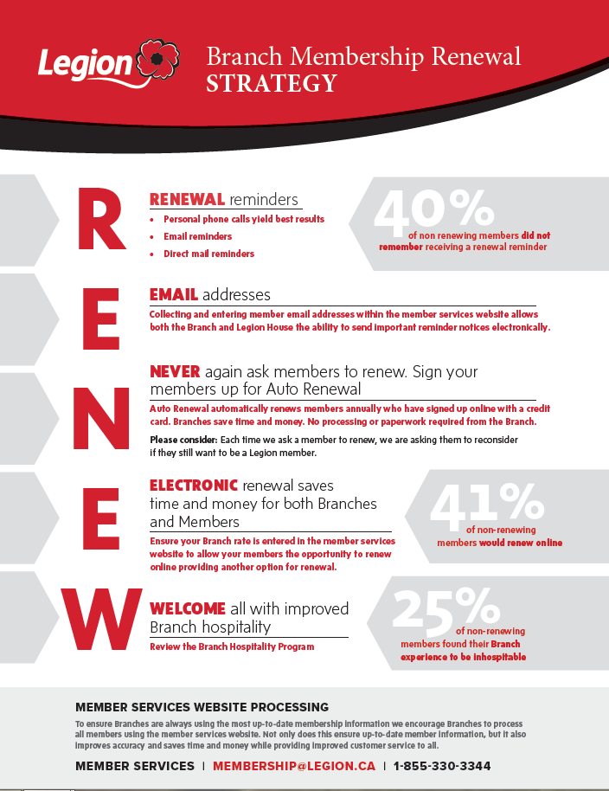

Slide 39
S.E.R.V.I.C.E.
S-mile
E-nquire
R-emember
V-ery nice to see you
I -ntroduce
C-onnect
E-ntice to Join

Slide 40
Poppy

Slide 41
Poppy
Campaign
Poster Literary
Programs
Use of Funds

Slide 42
ROUND TABLE
ANY QUESTIONS OR FEEDBACK?

